Slide 1

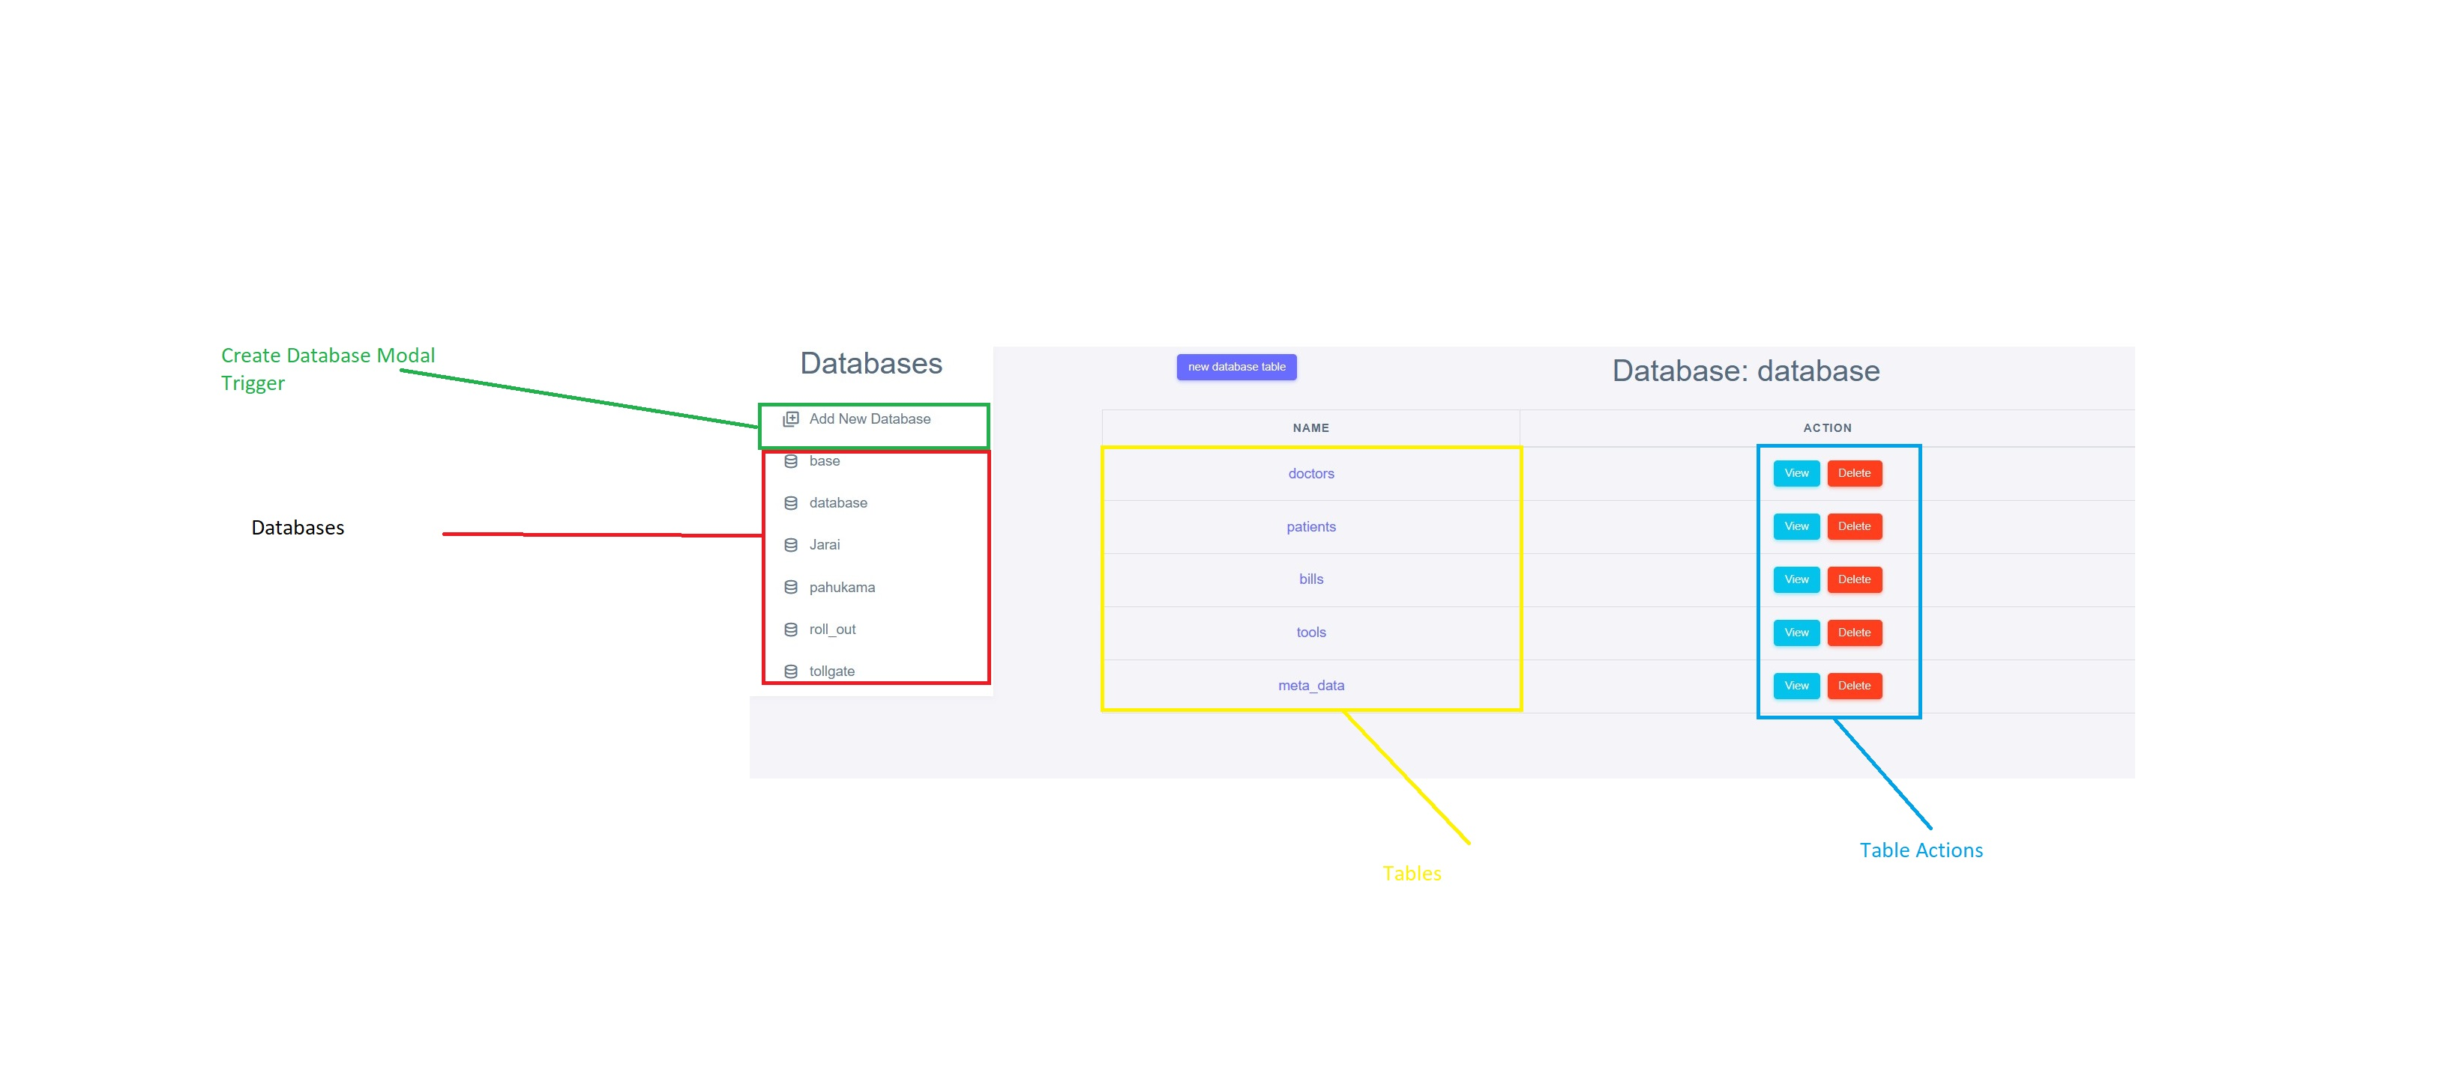
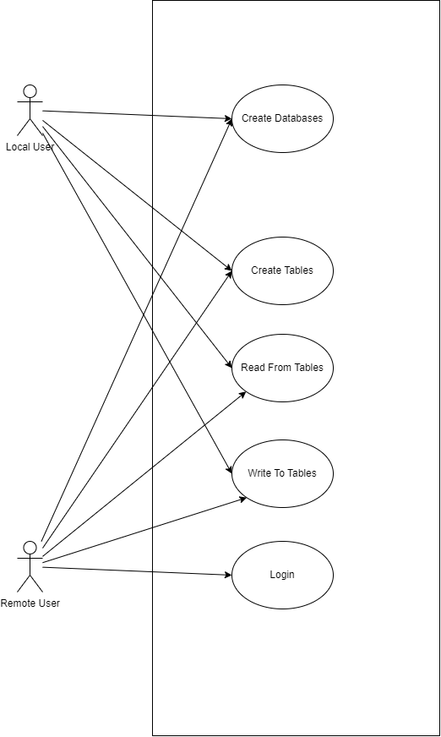
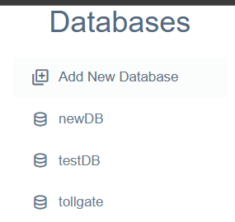
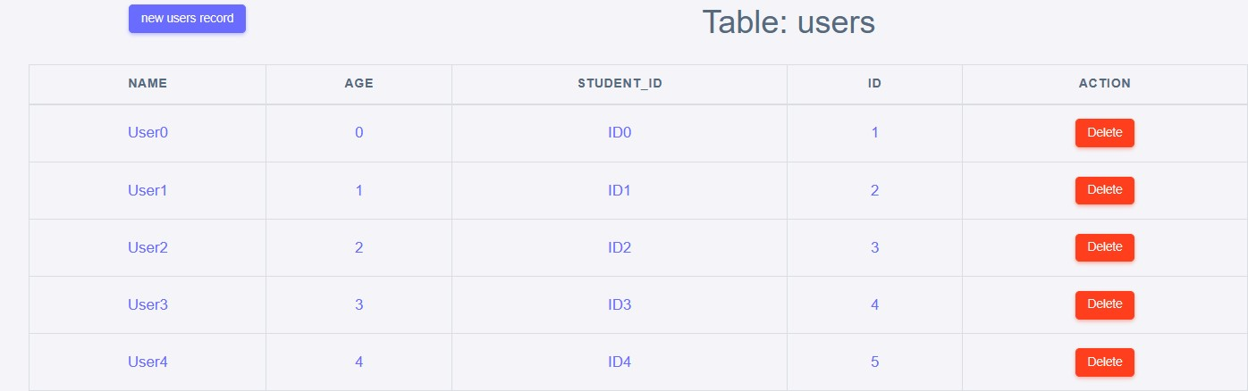
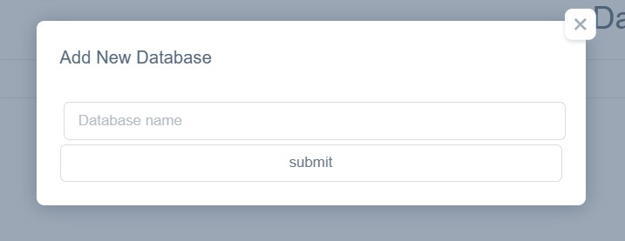
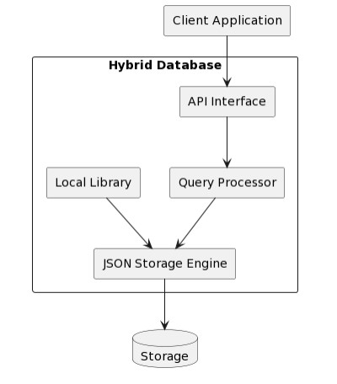
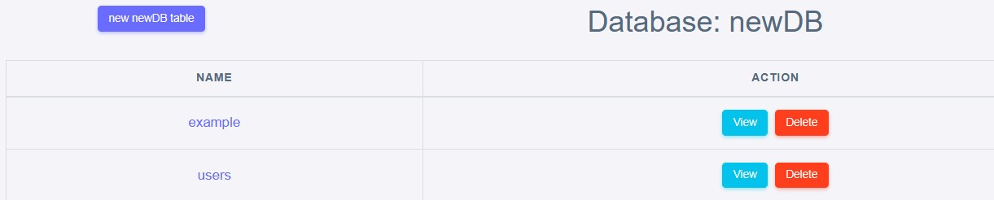
HYBRID JSON DATABASE (TEXT BASED DATABASE)
Samuel Jarai - Software Engineering Department
1.0 Abstract
3.0. Problem definition
7.0. Use Case Diagram
This capstone project explores the design and implementation of a JSON based hybrid database that combines the features of client-server and server-less databases. A client-server database requires a separate server process to manage the data access requests from the client,while a server-less database runs as an embedded library or a cloud service that scales automatically. The hybrid database aims to offer advantages such as performance, reliability,
flexibility and cost-efficiency for different types of applications. The project describes the architecture, data model, query language and API of the hybrid database, as well as evaluates its functionality and performance using various benchmarks and use cases
Databases differ in features and performance by design. Client server databases like PostgreSQL and MySQL have more features but more overhead and hardware needs. Server-less databases like SQLite have less features but higher performance and lower hardware needs. But SQLite is bad for remote or concurrent access, as it is a file with no server. This limits its use for apps that need data from many devices or users. There is a trade-off between complexity and simplicity, and application needs and hardware capabilities for databases. There is a need for a new database that can have some of the key features of client server databases while keeping high performance and low hardware needs. Such a database would be good for apps on low-end devices like Raspberry Pi that need remote or concurrent data access.
4.0. Overview of the developed application
The proposed database management system allows low-end hardware devices to access data remotely or concurrently without compromising performance or features. The system uses a hybrid architecture that combines the advantages of client server and server-less databases.
Each of these components requires a unique data-design methodology that includes data modeling, schema definition and query optimization.
The system will be showing the features and performance of different types of databases and how they compare to the proposed system. The system will also demonstrate the application needs and hardware capabilities that affect the choice of database.
8.0. Screenshots
2.0. Introduction
The rapid growth of data generation and consumption in the modern world has led to an increased demand for efficient and flexible database management systems. Databases are essential tools for storing, organizing, and accessing data in various applications. However, different applications may have different requirements and preferences for database features, such as data types, query languages, scalability, and security. Therefore, it is desirable to have a database management system that can adapt to the needs of the users without compromising the performance of the system.The aim of this software engineering capstone
project is to design and implement a JSON-based hybrid database system that combines the features of client-server and serverless databases. The system is designed to provide performance, reliability, flexibility, and cost-efficiency for different types of applications. The system architecture, data model, query language, and API will be developed with the goal of creating a database management system that is highly scalable, easily maintainable,
and interoperable with other systems and services.The project will involve a thorough investigation of existing database management systems and their features, as well as an in_x0002_depth analysis of the requirements and constraints of the target application domain. The
implementation of the system will be carried out using modern software development practices and tools, and the functionality and performance of the system will be evaluated using various benchmarks and use cases.The outcome of this project will be a functional and efficient JSON-based hybrid database system that can be used in various applications, from small-scale personal projects to large-scale enterprise systems. The system will provide a flexible and scalable solution for managing complex data structures and processing complex queries, while maintaining low hardware requirements and ensuring high availability and fault tolerance. .
Conclusion
The results of the project show that the hybrid database system can provide advantages such as performance greater than that of serverless databases whilst providing a server. The system
can adapt to the needs of the users without compromising the performance of the system. Thesystem's performance was evaluated using various benchmarks and showed that it can
provide fast and efficient data access and query processing. The system's functionality was tested using various use cases and showed that it can handle various types of data and queries.
5.0. Objectives
• To create a storage engine.
• To allow for basic authentication in order to access the database system.
• To create a user interface for creating and managing databases and tables.
• To allow remote access of the data via API calls.
r.
/
Supervisor – Mr Manjoro
6.0. System Overview

